Slide 1
FAFSA COMPLETION WORKSHOPS 2024
JEFF CHRISTENSEN, ADVISOR/PROGRAM SPECIALIST, UPWARD BOUND PROGRAM

Slide 2
WHAT IS THE FAFSA?
Free Application for Federal Student Aid
Required for all students attending college that want to receive FEDERAL and STATE aid to pay for tuition and living expenses.
Must complete this application EVERY YEAR.
Available every year October 1
www.fafsa.gov

Slide 3
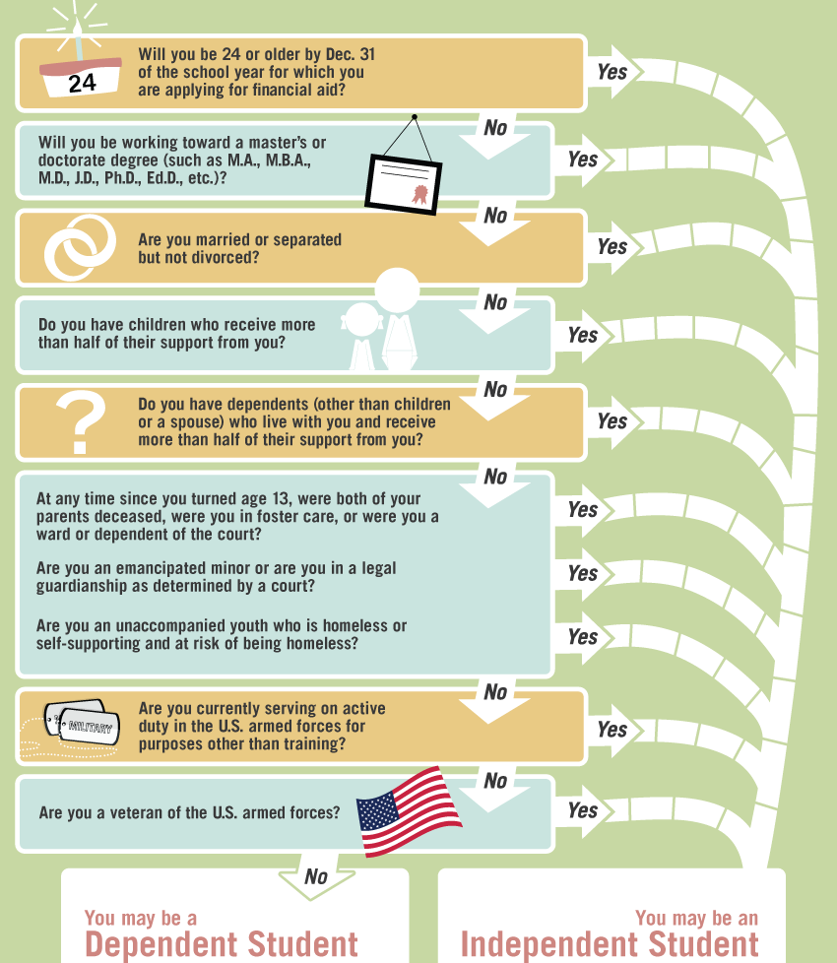
WHY DO WE ADD PARENT INFORMATION?
The Federal Government Decides who is DEPENDENT and INDEPENDENT!
https://studentaid.ed.gov/sa/fafsa/filling-out/dependency

Slide 4
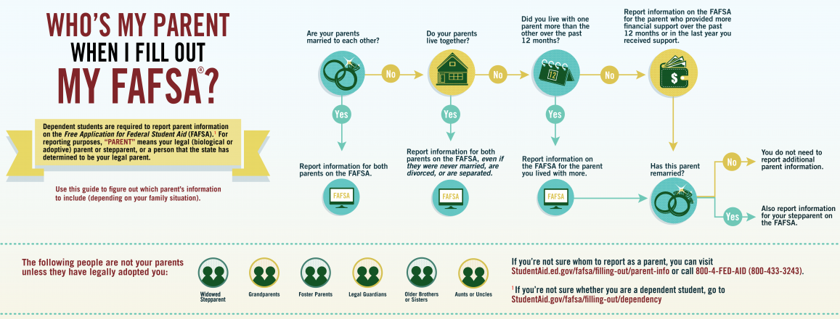
https://studentaid.ed.gov/sa/help/who-is-parent

Slide 5
WHAT IS THE FSA ID?
Student and ALL Contributors must have one to sign the FAFSA application.
You will need to REMEMBER the FSA ID’s for next year!
Parents: If you have multiple children go to college, or you go to college yourself, you will use the same FSA ID!
THE STUDENT AND PARENTS DIGITAL SIGNATURE
https://fsaid.ed.gov/

Slide 6
WHAT TAX INFORMATION DO I NEED?
Student 2023 FEDERAL return
1040
1040A
1040EZ
Parent(s) 2023 FEDERAL return
1040
1040A
1040EZ
Student 2023 W2 Wage statement(s)
Parent(s) 2023 W2 wage statement(s)
2023 FEDERAL TAXES, NOT STATE TAXES
TAXES FROM 2 YEARS PRIOR TO THE YEAR STARTING COLLEGE

Slide 7
HOW MANY SCHOOLS CAN I SEND MY FAFSA TO?
Send it to all schools you are looking at attending
You may send it to schools you didn’t apply to
Send it to UWSP, even if you don’t plan on attending here!
UNLIMITED! YOU CAN SEND UP TO 10 SCHOOLS PER FAFSA APPLICATION

Slide 8
AFTER THE FAFSA: WHAT HAPPENS NEXT?
https://www.youtube.com/watch?v=1c1gNefSw78#action=share

Slide 9
CORRECTIONS NEEDED, VERIFICATION, OR ADDITIONAL INFO
With the FAFSA Submission Summary, we can tell if:
Need to MAKE CORRECTIONS
Selected for VERIFICATION
Need to provide ADDITIONAL INFO

Slide 10
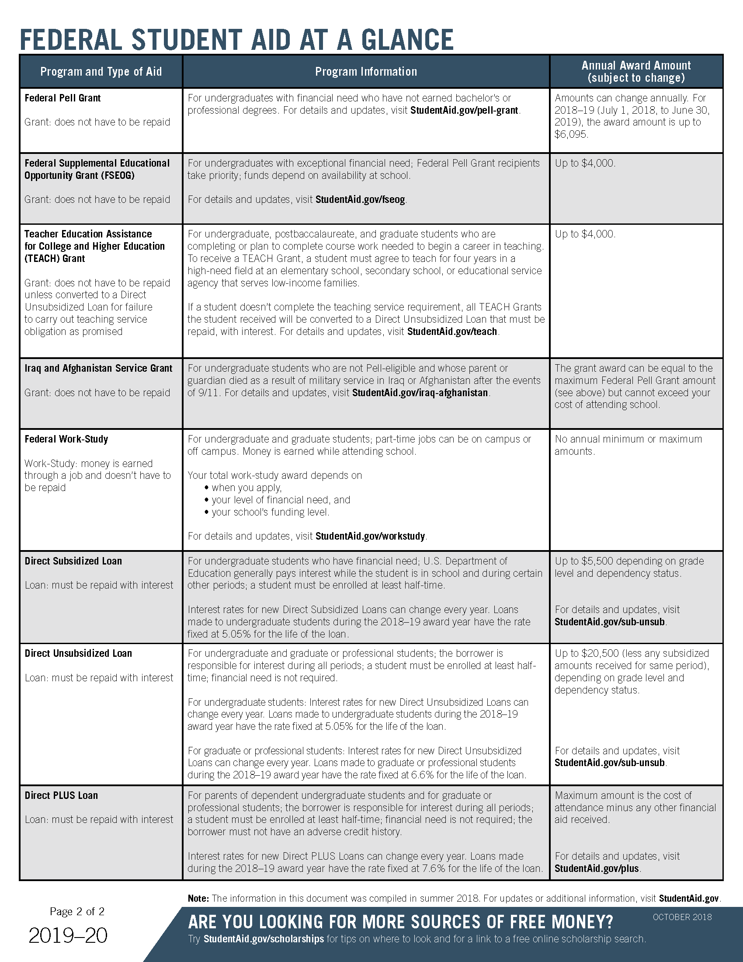
HANDOUT 2: FEDERAL STUDENT AID AT A GLANCE
Different types of FEDERAL aid

Slide 11
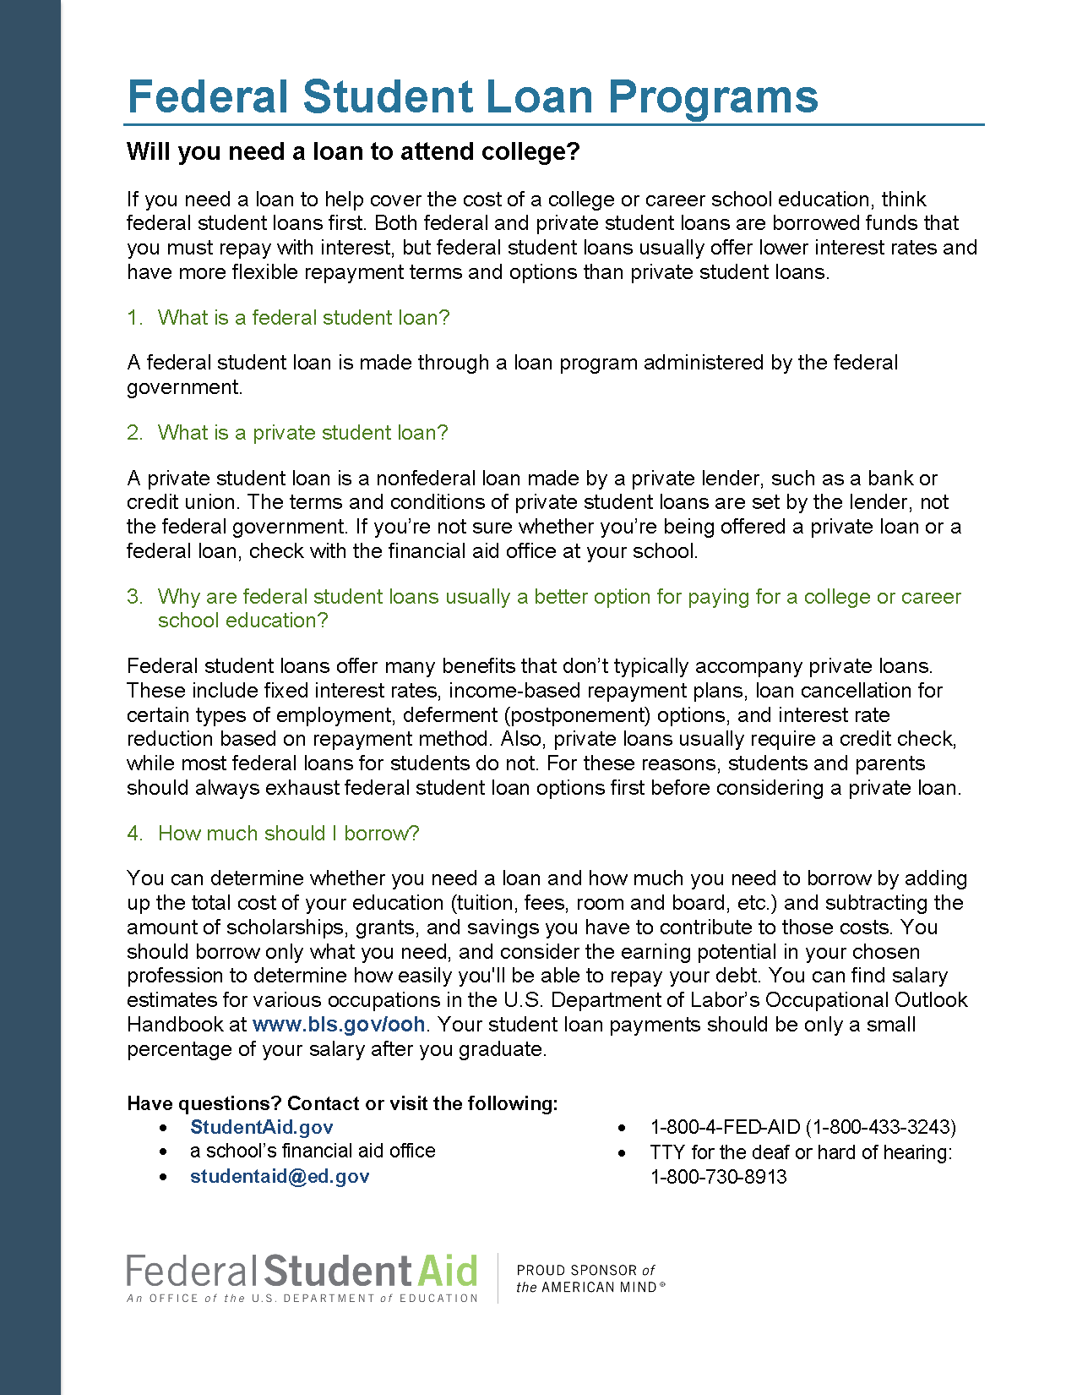
HANDOUT 3: FEDERAL STUDENT LOAN PROGRAMS
Different types of student loans
Questions about borrowing

Slide 12
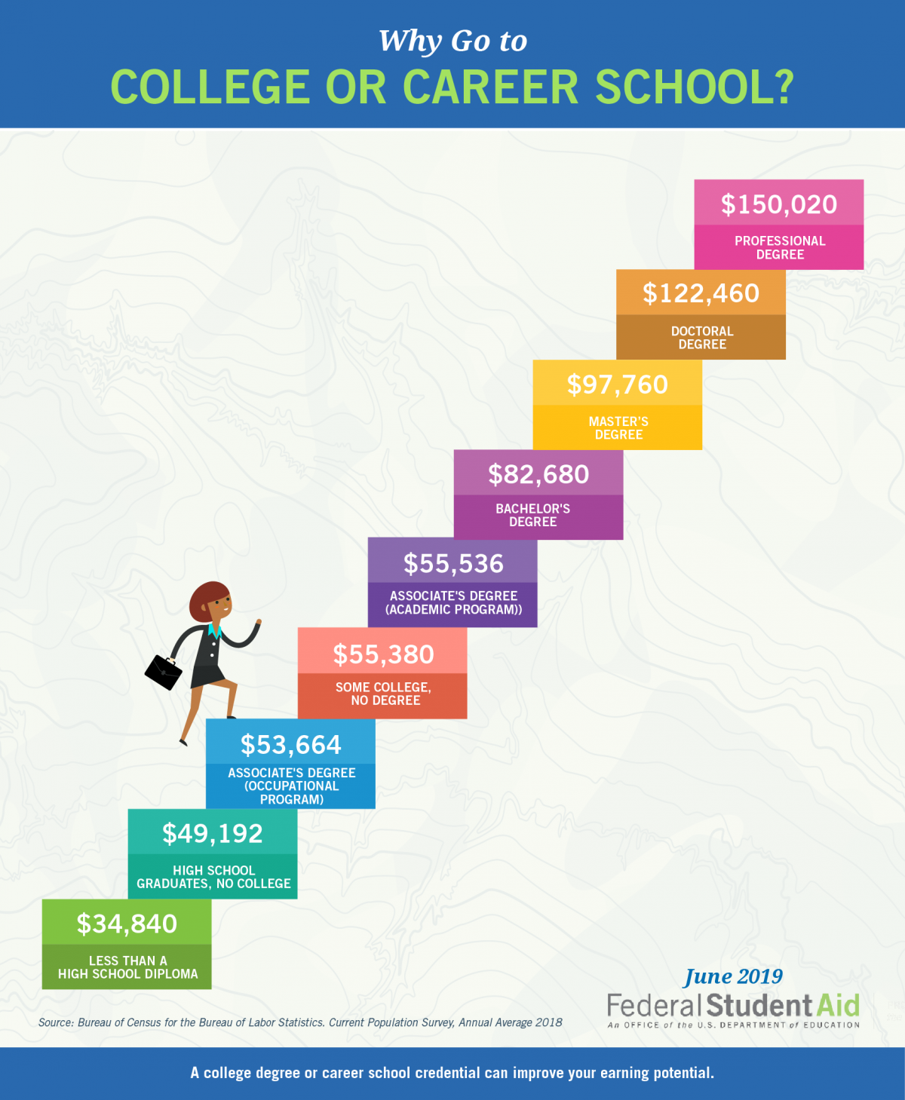
HANDOUT 4: WHY GO TO COLLEGE?

